Slide 1

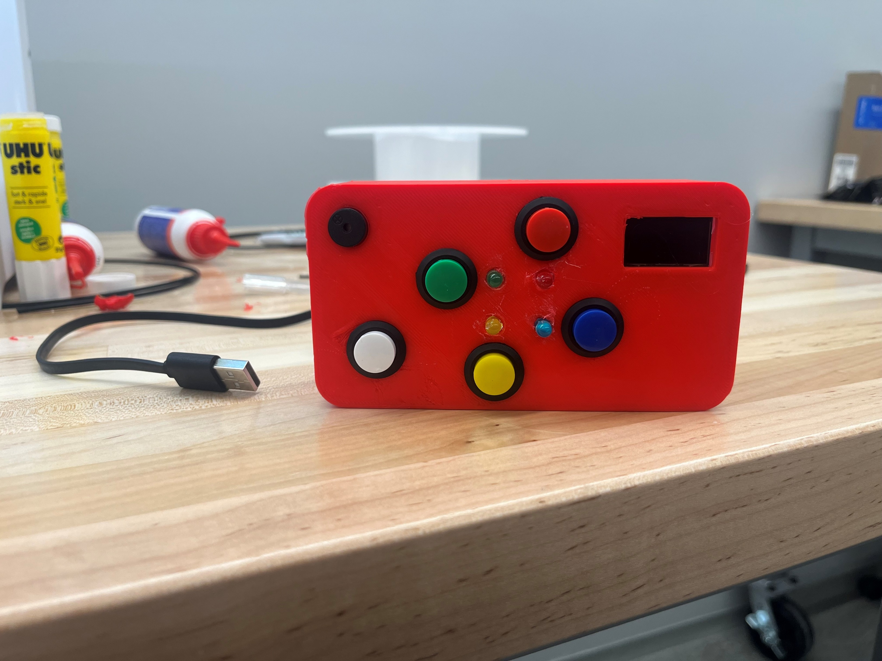
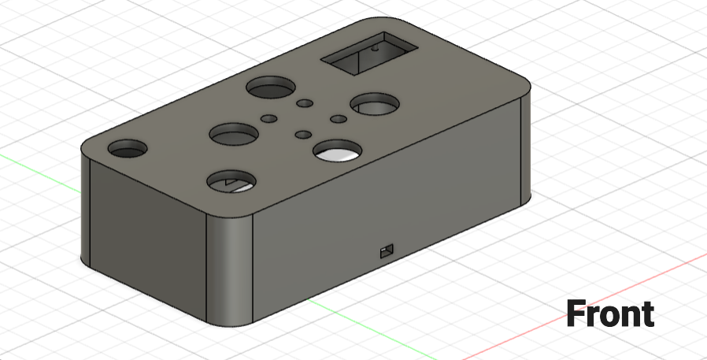
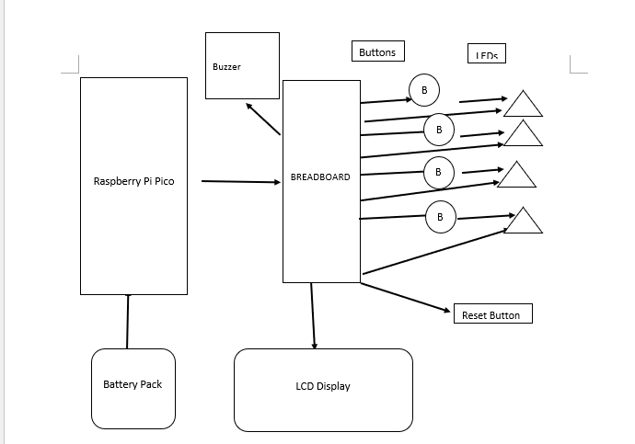
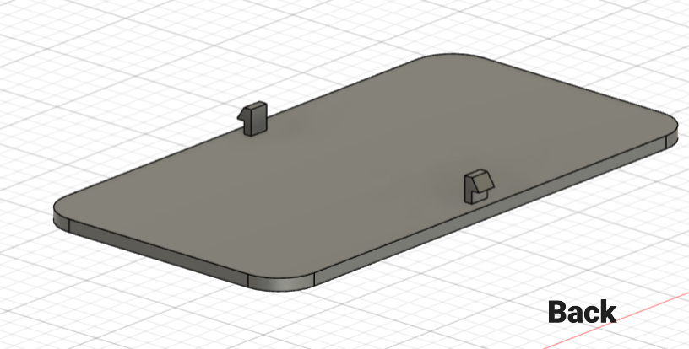

Color Combo
Bennett, Caleb; Davis, Laniyah
Abstract
Models
Final Product
We made a portable color memorization game where the players must remember the sequence of the flashing colors in the correct order. It is based off a popular portable toy in the late 70’s called “Simon”. Ours include an LCD screen where you can keep track of your current score, while also displaying the high score before the game starts.
Components
5 Buttons (~8.99 USD)
Includes 5 colored buttons: Red, Blue, Yellow, and Green and a buzzer.
4 LEDs(~8.99 USD)
Colored Red, Blue, Yellow, and Green
Battery Connector (23.99 USD)
An easy to purchase and install power source.
LCD Screen(~6.99 USD)
To display the current and highest score.
Breadboard(~ .30c )
Connects components together.
Raspberry Pi Pico (~7.49~ USD)
The main processor used to run the program.
Buzzer(~1.50 USD)
Makes noises and plays tones.
Fig. 1 - System Container
Results and Conclusion
After thoroughly testing, we can comfortably say that our portable memorization game has been successfully designed and implemented. The players could follow the sequence of flashing-colored LEDs by pushing the correct buttons. We are currently working through some issues the LCD display. Nevertheless, the device ran smoothly with the Raspberry Pi Pico as the main processor.
The game successfully replicated the classic "Simon" concept, creating an entertaining and engaging experience.
Methods and Overview
The design will be handheld, and battery operated. It will consist of four buttons each representing their own color, another button to reset the game, an LCD display to show the high score, a switch to turn the game on and off, and a breadboard to connect all the components together. The program will be computed via the Raspberry Pi Pico and will output one of the four colored LEDs depending on the combination of inputs. The four colors are: Red, Blue, Green, and Yellow. The program runs by randomly adding a color to the sequence and the player must replicate that sequence. For example, if the LED flashes red, the player must press the button coordinated with the red LED. Then, it will flash the Red LED and then the Blue LED, to which the player must press the Red button and the Blue button in that order. The game will keep adding colors to the sequence until the player presses a button that is out of order. Once that happens, the program will then display the highest score.
Fig. 2 - Block Diagram
Acknowledgements
We thank Dr. Hoan Ngo for his guidance and support on this project.

